Slide 1

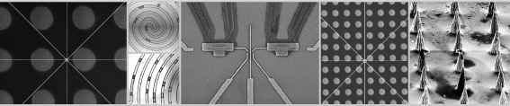
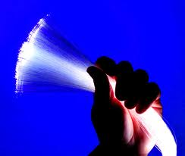
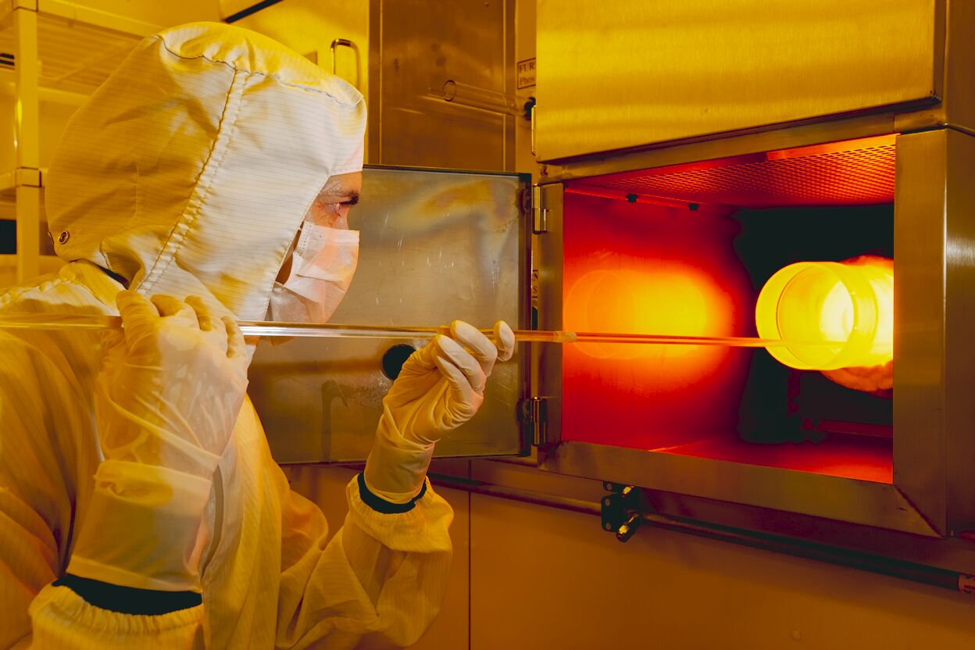
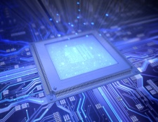
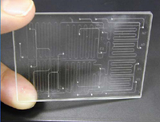
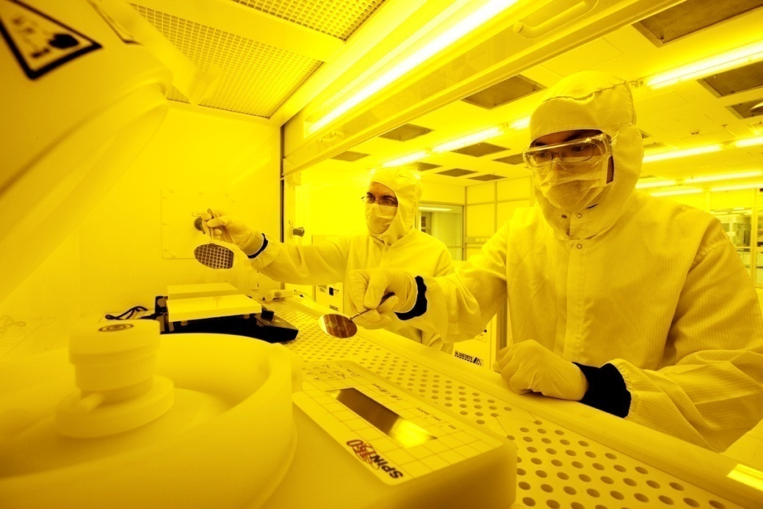
Welcome to the
Australian National Fabrication Facility
Providing nano and micro-fabrication facilities for Australia’s researchers
Matthew Chen matthew.chen@anff.org.au
Notes:
Supporting innovation & industry – establishing Australia’s nanofabrication infrastructure
Collaboration & Innovation Using Cutting Edge Research Infrastructure

Slide 2

Outline
What is ANFF?
What can ANFF do for you?
Around the Nodes
Accessing ANFF
Notes:
Supporting innovation & industry – establishing Australia’s nanofabrication infrastructure
Collaboration & Innovation Using Cutting Edge Research Infrastructure

Slide 3

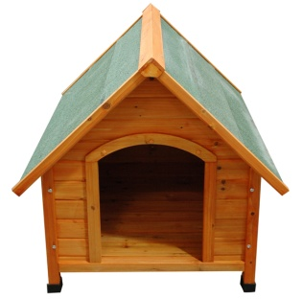
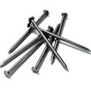
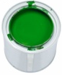
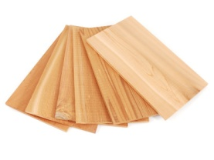


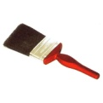
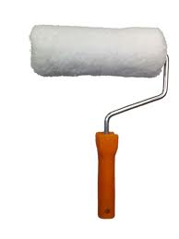
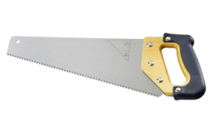
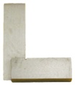
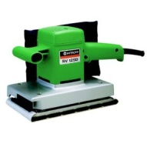
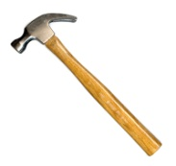
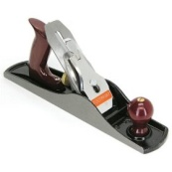
=
+
Tools?

Slide 4
What is ANFF?
VIC/MCN
OptoFab
QLD
ACT
WA
Materials
NSW
VIC/MCN
A central organisation that provides access to a network of facilities and instrumentation across 8 university based nodes
Associated technical expertise to assist with your fabrication needs
National network allows access to a broad range of capabilities and expertise from across Australia
WA
Materials
ACT
OptoFab
South Aust
NSW
QLD
Notes:
Supporting innovation & industry – establishing Australia’s nanofabrication infrastructure
Collaboration & Innovation Using Cutting Edge Research Infrastructure

Slide 5





















Notes:
A significant proportion of Australia’s 38 universities have come together under NCRIS to form ANFF

Slide 6



What can ANFF do for you?
Access to first-class research and fabrication facilities across Australia
Highly qualified personnel to assist with your fabrication needs
Experience and proven expertise across a broad range of capabilities
Notes:
Supporting innovation & industry – establishing Australia’s nanofabrication infrastructure
Collaboration & Innovation Using Cutting Edge Research Infrastructure

Slide 7
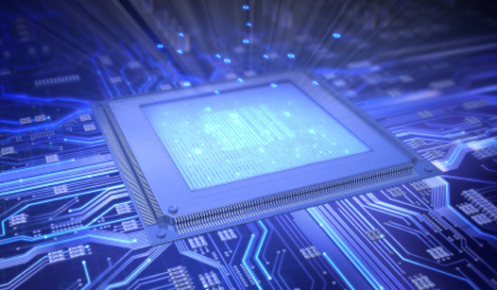
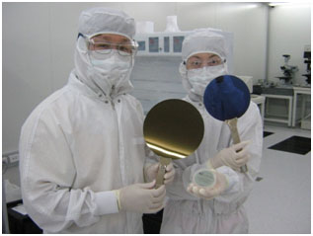
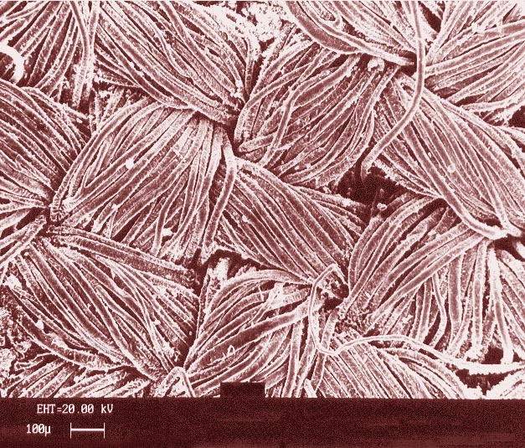
Nanoelectronics & photonics
Ultra-high resolution EBL
Semiconductor processing
Advanced deposition and etching
Notes:
The 3 principle areas of activity are:
Nanoelectronics & photonics
Sensors and medical devices
Materials processing
Electron-beam lithography for large area structures, especially in nanoelectronics; ultra-high resolution EBL for small scale prototype devices; and semiconductor device prototyping.

Slide 8
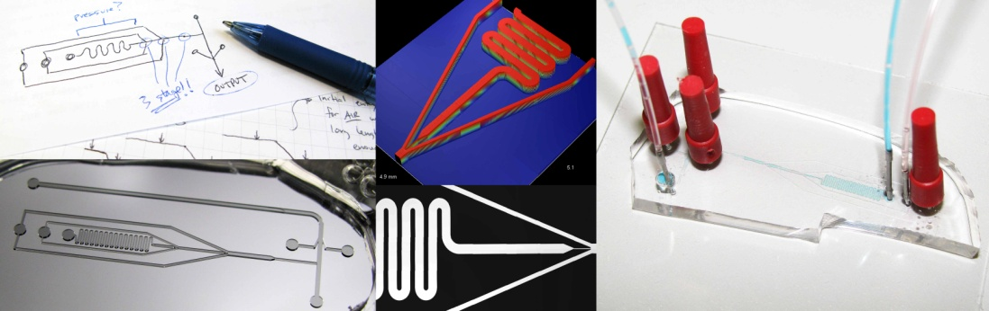
Sensors & medical devices
Bio-nano device fabrication
Advanced photoresist
Functional organics

Slide 9
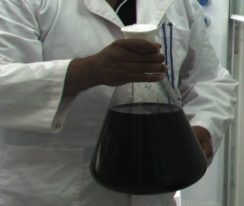
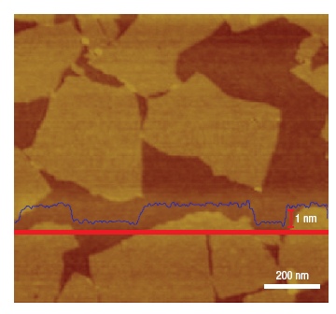
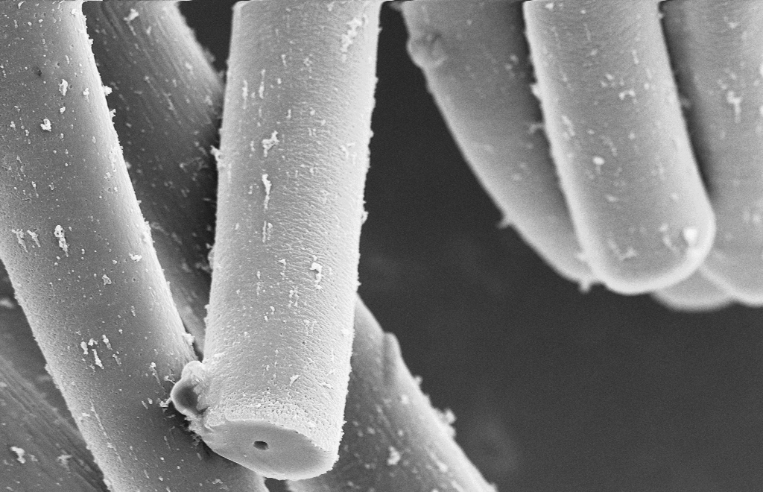
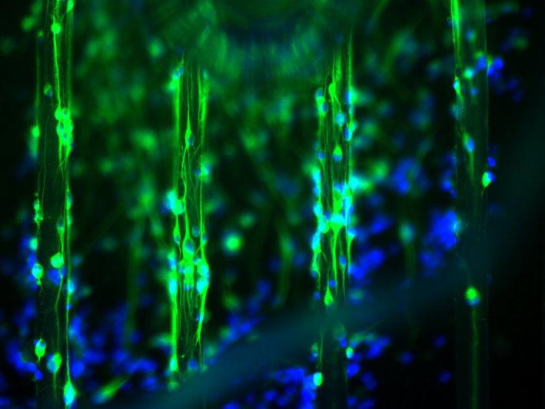
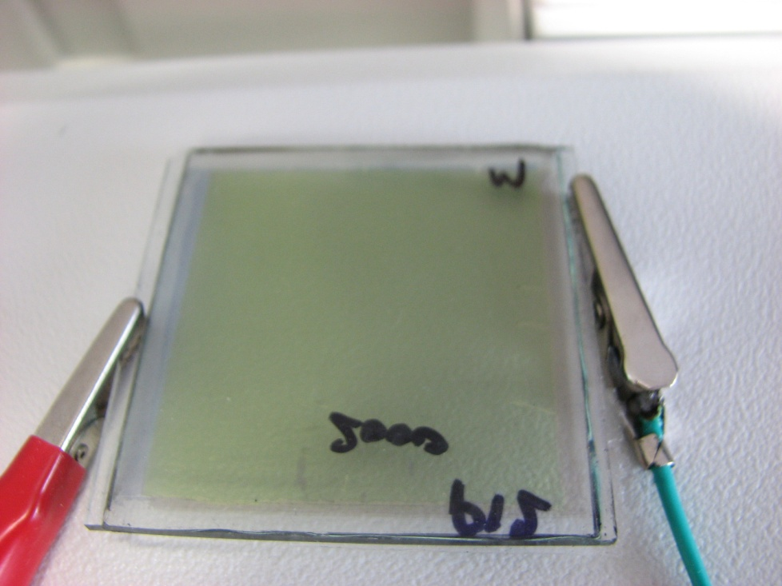
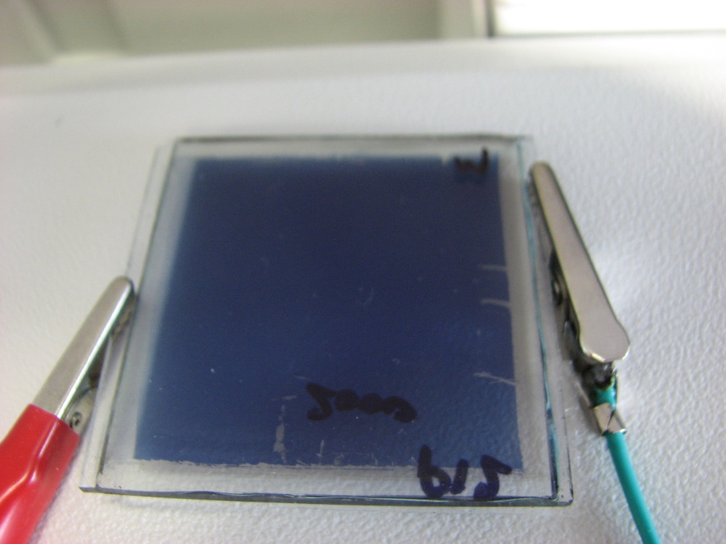
Advanced Materials
Biomaterials
CCG (Chemically Converted Graphene) Dispersion (0.5 mg/ml )
Conducting Polymers
OPV Dyes
Electrochromic materials
Notes:
All of these characteristics that have bio applications for the UQLD groups can also be applied to minerals processing in SA.
Biological
Minerals processing
Improved performance, Faster analysis time, Lower reagent and sample consumption

Slide 10
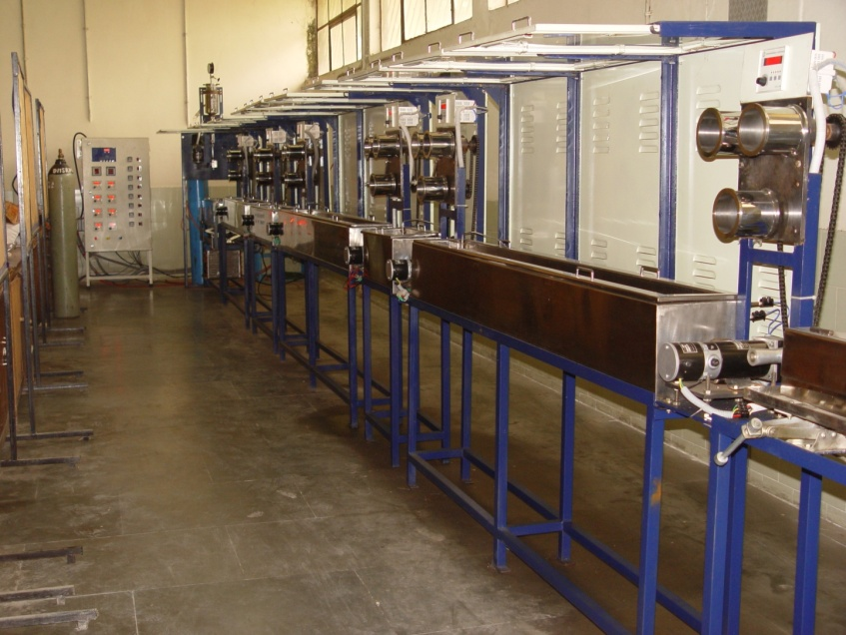
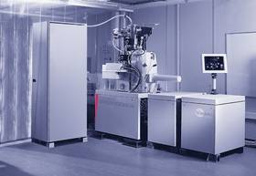
Process scaling
Reel-to-reel printing
Pilot scale synthesis
Fibre Spinning
Ability to process large wafers
Notes:
In structuring our EIF investments we’ve focussed on process scaling across all disciplines: 6 inch wafers, increasing from grams to kgs of advanced material production (interesting challenges with highly exothermic reactions), reel-to-reel printing of organic electronic devices, and minerals processing by putting MANY microfluidic chips together.
Hugely exciting!
Microfluidics fabrication facility: UV lithography suite, DRIE
Surface treatment facility: RF plasma reactor, spray polymerisation reactor, dip coater, micro plasma pen
Patterning and texturing facility: sputter deposition system, direct write deposition system, CNC micro milling system
Improved performance
Faster analysis time
Lower reagent and sample consumption
Easy & automated operation

Slide 11
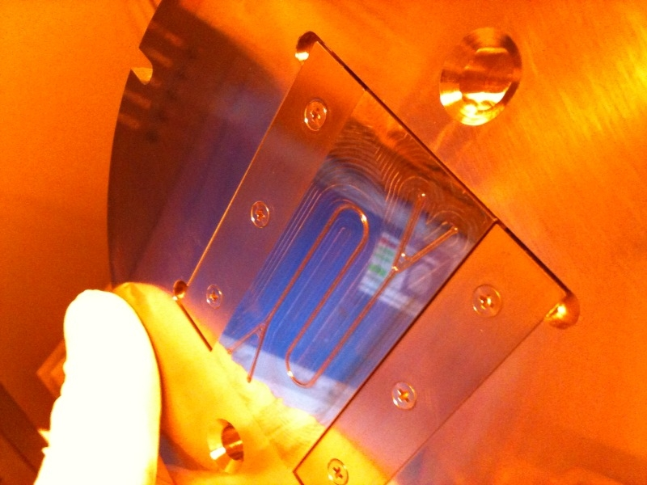
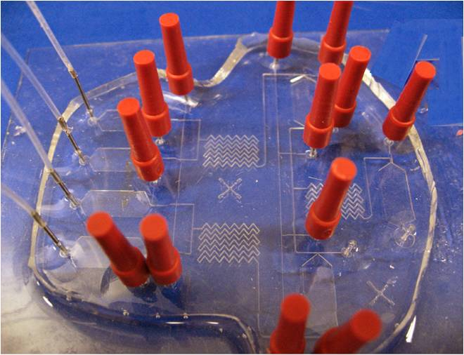
Microfluidics
Notes:
All of these characteristics that have bio applications for the UQLD groups can also be applied to minerals processing in SA.
Biological
Minerals processing
Improved performance, Faster analysis time, Lower reagent and sample consumption

Slide 12
Linking expertise
VIC/MCN
OptoFab
QLD
ACT
WA
Materials
NSW
VIC/MCN
WA
Materials
ACT
OptoFab
South Aust
NSW
QLD
Notes:
May not show same picture, may use group shot

Slide 13
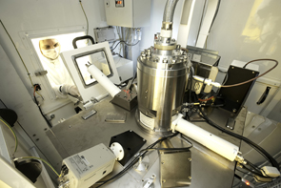
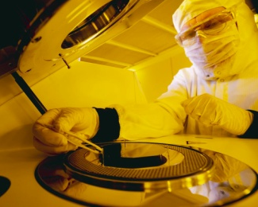
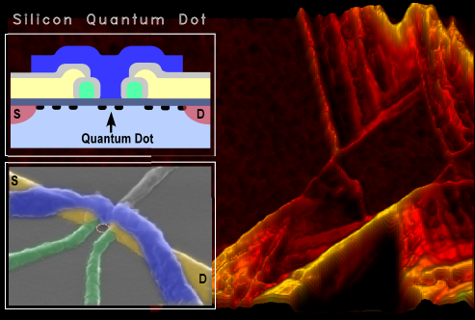
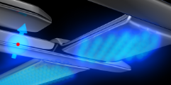
NSW Node
Key expertise: | Nanoelectronics and nano-spintronics
Key capabilities: | - High resolution electron beam lithography - Si MOS process line - Advanced deposition and etching
User highlights
Silicon quantum dot, produced by CQCT using ANFF-NSW’s facilities
Featured on the cover of Applied Physics Letters
[Lim et al, Applied Physics Letters 94, 173502 (2009)].
Single electron reader, representing a significant breakthrough in Si-based quantum computation [see Morello et al, Nature 467, 687 (2010)].
Notes:
Now have overview with a slide or two on each of the seven NCRIS nodes

Slide 14
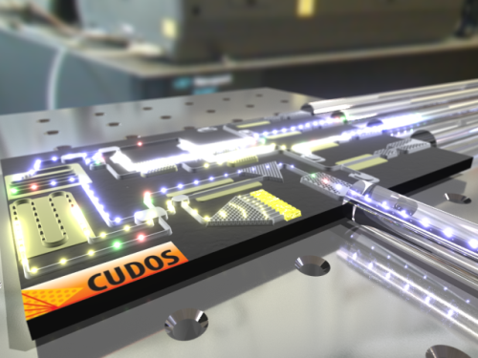
ACT Node
Key expertise: | III-V Compound Semiconductors Optoelectronics, waveguides, photonic crystals, Micro electromechanical systems (MEMS)
Key capabilities: | Growth of III-V compound semiconductor multilayers Electron beam lithography Advanced deposition and etching
User highlights
Photonic chips made by CUDOS using ANFF ACT’s facilities.
The chips were made from chalcogenide glass, allowing nonlinear optics in optimized materials and nanostructures, enabling high speed information processing beyond limits of electronics,
Notes:
ICP deposition, ICP evaporation, thermal/ebeam evaporator
NIL
FIB
3-5 band gap materials are suited to optoelectronics applications

Slide 15
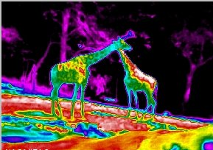
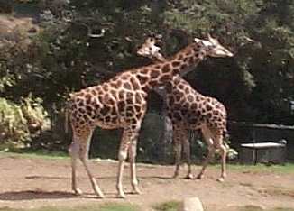
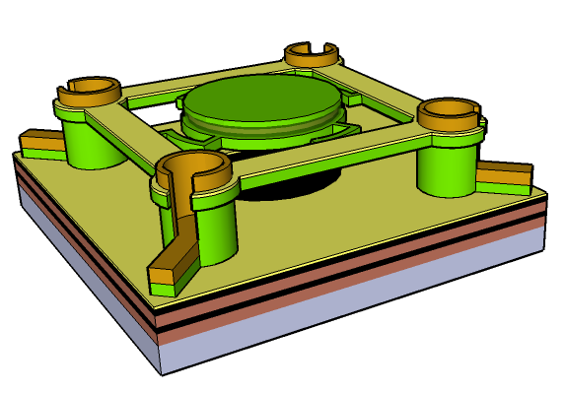
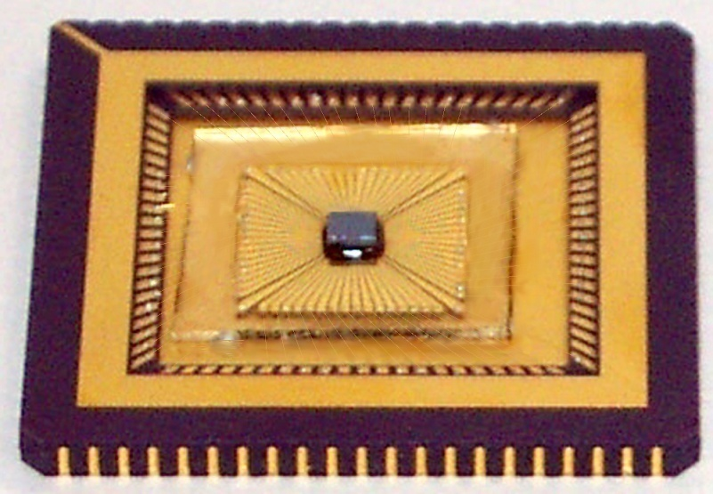
WA Node
Key expertise: | II-VI Compound semiconductors Optical nano/micro electromechanical systems Infra-red array /sensor technology
Key capabilities: | Integrated II-VI semiconductor growth, device fabrication, processing to device packaging & characterization Advanced deposition and etching
User highlights
Incident
IR
Reflected
IR
Mirror
Silicon Nitride
V
Cavity Length, d
Mirror
Detector
d = 900nm
d = 1700nm
‘Coloured' Infrared - researchers at the ANFF WA node created a minaturised hyperspectral spectrometer on a chip that enables colour vision in infra-red night vision
Notes:
Microfluidics fabrication facility: UV lithography suite, DRIE
Surface treatment facility: RF plasma reactor, spray polymerisation reactor, dip coater, micro plasma pen
Patterning and texturing facility: sputter deposition system, direct write deposition system, CNC micro milling system
Improved performance
Faster analysis time
Lower reagent and sample consumption
Easy & automated operation
micro and nano scale patterning; microfluidic device fabrication

Slide 16

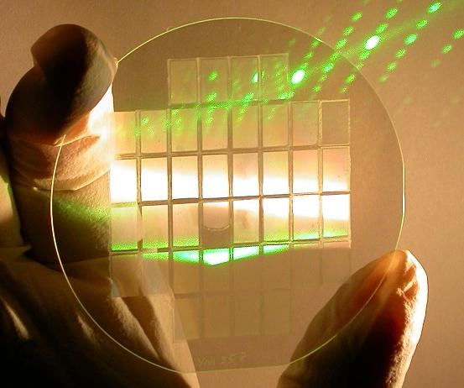
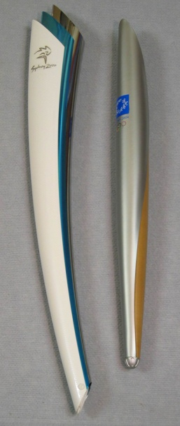
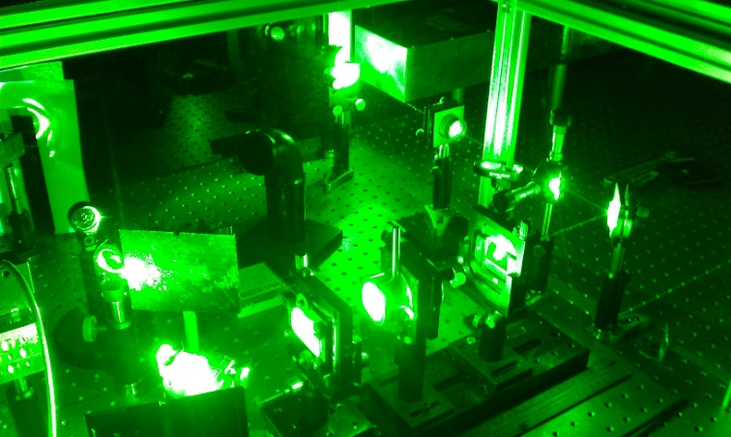
OptoFab Node
Key expertise: | Optical materials, components and devices Laser micro-machining
Key capabilities: | Advanced photolithography (e.g. photomask production) Optical characterisation Optical fibre and Lithium niobate device fabrication Laser micro-machining
User highlights
Olympic torches for the Sydney 2000 and Athens 2004 Olympics
Nozzle outlet were laser machined by the frequency doubled Nd:YAG laser
Notes:
planar lightwave circuit fabrication via the initial creation of a lithographic mask (Bandwidth Foundry), production of an integrated optoelectronic chip (Macquarie) and excellent signal throughput via efficient coupling to purpose-designed mode matched fibres (Adelaide).

Slide 17
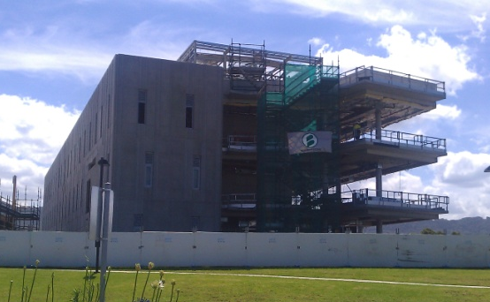
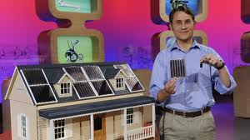

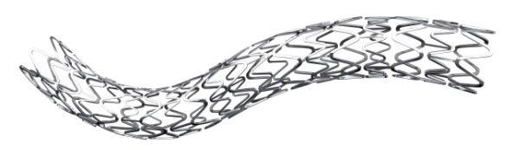
Materials Node
Key expertise: | Novel polymer and ceramic nanomaterials Organic Electronic devices Batteries and Energy storage
Key capabilities: | Design and fabrication of organic/ inorganic nanostructured materials/devices Pilot-scale fabrication for proof of concept Inkjet printing
  Australian Institute for Innovative Materials (AIIM) Processing & Devices
User highlights
“Solar Paint”
– a water soluble organic photovoltaic paint made by Prof. Dastoor’s group at UoN.
Top 5 finalist on ABC’s hit show
“The New Inventors”
Notes:
Don’t mention much on it

Slide 18

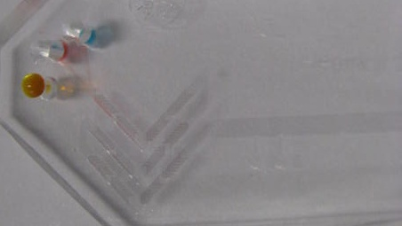
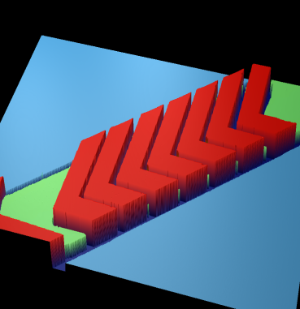
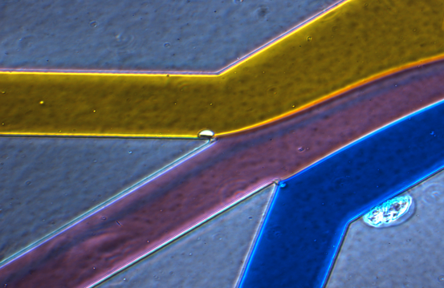
Queensland Node
Key expertise: | Bio-Micro-Nano Devices Design, Fabrication and Characterisation
Key capabilities: | Advanced photoresist synthesis Bio-nano device fabrication Functional organic/polymer and bio-inspired nanomaterials Surface and device characterisation Fabrication and Processing of Silica Carbide (SiC)
User highlights
Non Invasive Saliva diagnostic device :
For early detection of cardiovascular diseases. Immunoassay of biomarkers performed in 15min rather than 2 hrs.
Notes:
2011-2012
Silicon carbide epitaxial reactor Mk II
Growth of 3C SiC on Si, amorphous SiC, nano wire SiC and nanocrystaline SiC
Immunoassay process onto a microfluidics chip
2hrs vs 15min
Biomarker

Slide 19
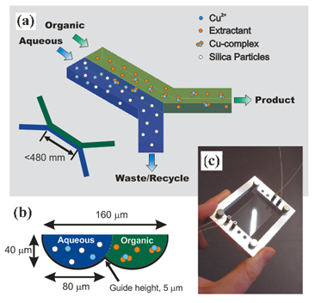
South Australian Node
Key expertise: | Microfluidic devices Micro and nano scale patterning
Key capabilities: | Prototyping and replication of micro-scale channels Chemical and physical surface functionalisation and characterisation Texturing and patterning of surfaces
User highlights
Solvent Extraction Microchip - a schematic of a chip created by the Ian Wark institute.
Has the ability to process 100x faster than large scale solvent extraction.
Priest, C., et al., Microﬂuidic extraction of copper from particle-laden solutions, Int. J. Miner. Process. (2010),
http://dx.doi.org/10.1016/j.minpro.2010.11.005
Notes:
Microfluidics fabrication facility: UV lithography suite, DRIE
Surface treatment facility: RF plasma reactor, spray polymerisation reactor, dip coater, micro plasma pen
Patterning and texturing facility: sputter deposition system, direct write deposition system, CNC micro milling system
Improved performance
Faster analysis time
Lower reagent and sample consumption
Easy & automated operation
micro and nano scale patterning; microfluidic device fabrication

Slide 20








Victorian Node
Key expertise: | Unique facility comprising of both biological and non-biological nano-fabrication techniques
Key capabilities: | Photo- and electron beam lithography Advanced deposition and etching Rapid prototyping Novel techniques such as embossing, inkjet printing and electroforming.
Flagship instruments
Deposition Equipments
PECVD
Ion assisted DC/RF Sputtering
E-Beam and Thermal Evaporator
EBL (Vistec EBPG5000PLUS)
<10nm resolution
Fastest system in Australia.
High res
dual-beam Helios FIB/ SEM
One of only 3 in Australia.
Photolithography
System
(EVG620 UV)
Can take up to 150mm substrates.
Laser scanning Confocal microscope
(Nikon A1Rsi MP)
Biologoical AFM
DRIEs
2xPlasmalab 100 ICP380
Notes:
Photolithography - Automated mask alignment and Nano Imprint Lithography system
Also have the hot embosser

Slide 21

Melbourne Centre of Nanofabrication (MCN)
Photolithography
E-beam
SEM
Polymer Electronics
PVD & RIE
Electroplating
Characterisation Lab
Wet Chemistry
PC2 Lab
Microscopy
Bio-chem lab
Nanoparticle lab
PDMS lab

Slide 22
Our Capabilities
We do a LOT!
If in doubt, please ASK!
Notes:
Supporting innovation & industry – establishing Australia’s nanofabrication infrastructure
Collaboration & Innovation Using Cutting Edge Research Infrastructure

Slide 23


Accessing ANFF
ANFF Users
  University researchers
  Government funded research centres
  Industry, SMEs, start-ups
Accessing Costs
  Access to instruments and relevant training are charged at hourly rates
  Rates vary according to the instrument requested
  Speciality materials or devices may be fabricated by Process Engineers for an additional cost
ANYONE interested in nanofabrication
Notes:
AAHL = Australian Animal Health Laboratory
A lot of time here

Slide 24
Access Procedure
Contact ANFF
Assess request
feasibility
Complete User Proposal
Contact Node
Approval Process
Access Committee
YES
New user?
NO
User Induction
Training
Job performed by ANFF staff

Slide 25

More Information
www.anff.org.au

Slide 26






Acknowledgements

Slide 27

BANFF

Slide 28

Providing nano and micro-fabrication facilities for Australia’s researchers
www.anff.org.au

